Slide 1
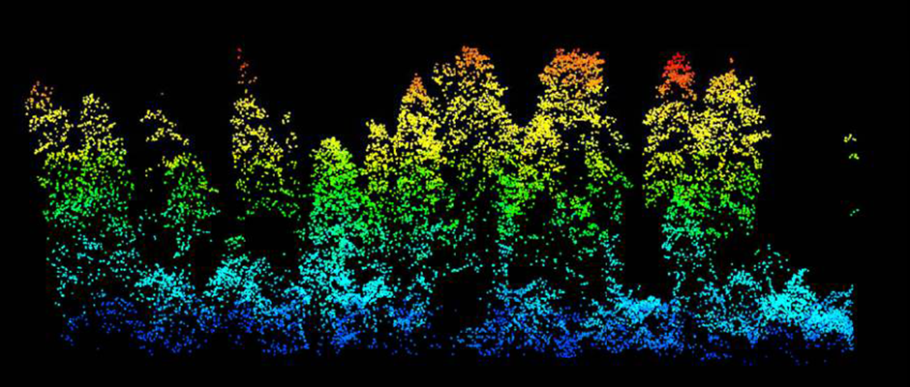
forest3D
David Diaz, Martin Bagaram, Zhehao Li
wildlife.org

Slide 2
Tree Data Pre-Processing
functional requirements:
Read in raw tree list data in text (*.txt, *.csv) and geospatial (*.shp) file formats
Retain desired attributes from different data sources, reformat to consistent specs
Identify coordinate reference system, if present; project locations to known coordinate system

Slide 3
Tree Data Pre-Processing
Pandas, GeoPandas
ArcPy, ArcGIS, QGIS
How it works
Advantages
Disadvantages
How it works
Advantages
Disadvantages

